Slide 1
Systems Analysis and Design
Chapter 4-5-6-7
Part -3
Chapter 5
Data and Process Modeling

Slide 2
Chapter Objectives
Describe data and process modeling concepts and tools, including data flow diagrams, a data dictionary, and process descriptions
Describe the symbols used in data flow diagrams and explain the rules for their use
Draw data flow diagrams in a sequence, from general to specific
Explain how to level and balance a set of data flow diagrams

Slide 3
Chapter Objectives
Describe how a data dictionary is used and what it contains
Use process description tools, including structured English, decision tables, and decision trees
Describe the relationship between logical and physical models

Slide 4
Introduction
In Chapters 5 & 6, you will develop a logical model of the proposed system and document the system requirements
Logical model shows what the system must do
Physical model describes how the system will be constructed

Slide 5
Overview of Data and Process Modeling Tools
Systems analysts use many graphical techniques to describe an information system
A data flow diagram (DFD) uses various symbols to show how the system transforms input data into useful information

Slide 6

Data Flow Diagrams
A data flow diagram (DFD) shows how data moves through an information system but does not show program logic or processing steps
A set of DFDs provides a logical model that shows what the system does, not how it does it

Slide 7
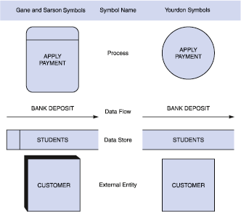
Data Flow Diagrams
DFD Symbols

Slide 8
Data Flow Diagrams
DFD Symbols
Process symbol
Receives input data and produces output that has a different content, form, or both
Contain the business logic, also called business rules
Referred to as a black box

Slide 9
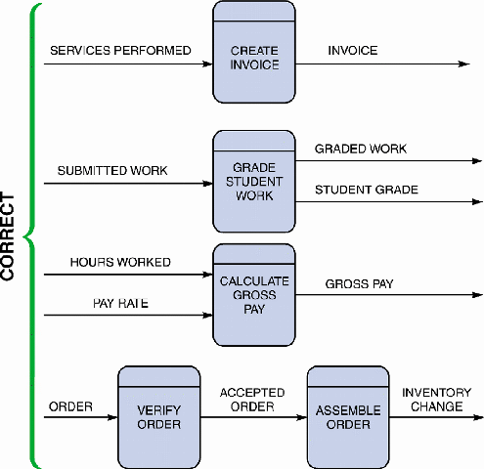
Data Flow Diagrams
DFD Symbols
Data flow symbol
Represents one or more data items
The symbol for a data flow is a line with a single or double arrowhead
Spontaneous generation
Black hole
Gray hole

Slide 10
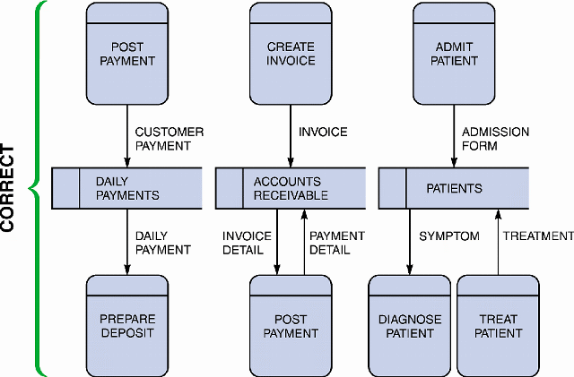
Data Flow Diagrams
DFD Symbols
Data store symbol
Represent data that the system stores
The physical characteristics of a data store are unimportant because you are concerned only with a logical model

Slide 11
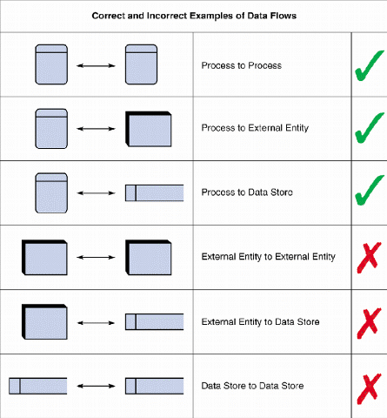
Data Flow Diagrams
DFD Symbols
Entity Symbol
Name of the entity appears inside the symbol
Terminators
Source
Sink

Slide 12
Creating a Set of DFDs
Create a graphical model of the information system based on your fact-finding results
First, you will review a set of guidelines for drawing DFDs. Then you will learn how to apply these guidelines and create a set of DFDs using a three-step process

Slide 13
Creating a Set of DFDs
Guidelines for Drawing DFDs
Draw the context diagram so that it fits on one page
Use the name of the information system as the process name in the context diagram
Use unique names within each set of symbols

Slide 14
Creating a Set of DFDs
Guidelines for Drawing DFDs
Do not cross lines
Provide a unique name and reference number for each process
Obtain as much user input and feedback as possible

Slide 15
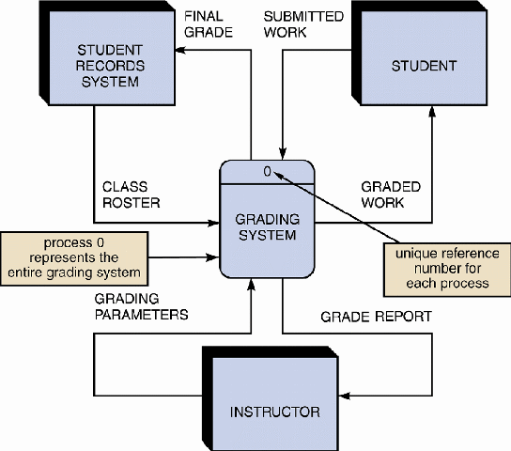
Creating a Set of DFDs
Step 1: Draw a Context Diagram

Slide 16
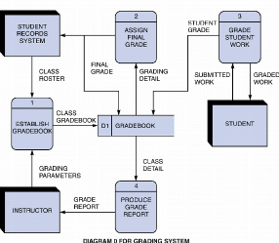
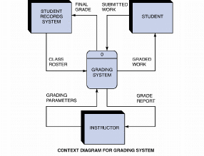
Creating a Set of DFDs
Step 2: Draw a Diagram 0 DFD

Slide 17
Creating a Set of DFDs
Step 2: Draw a Diagram 0 DFD
If same data flows in both directions, you can use a double-headed arrow
Diagram 0 is an exploded view of process 0
Parent diagram
Child diagram
Functional primitive

Slide 18
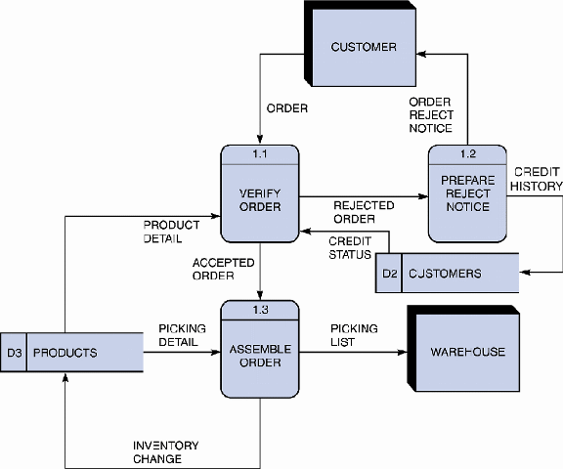
Creating a Set of DFDs
Step 3: Draw the Lower-Level Diagrams
Must use leveling and balancing techniques
Leveling examples
Uses a series of increasingly detailed DFDs to describe an information system
Exploding, partitioning, or decomposing

Slide 19
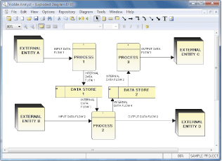
Creating a Set of DFDs
Step 3: Draw the Lower-Level Diagrams
Balancing Examples
Ensures that the input and output data flows of the parent DFD are maintained on the child DFD

Slide 20
Data Dictionary
A data dictionary, or data repository, is a central storehouse of information about the system’s data
An analyst uses the data dictionary to collect, document, and organize specific facts about the system
Also defines and describes all data elements and meaningful combinations of data elements

Slide 21
Data Dictionary
A data element, also called a data item or field, is the smallest piece of data that has meaning
Data elements are combined into records, also called data structures
A record is a meaningful combination of related data elements that is included in a data flow or retained in a data store

Slide 22
Data Dictionary
Using CASE Tools for Documentation
The more complex the system, the more difficult it is to maintain full and accurate documentation
Modern CASE tools simplify the task
A CASE repository ensures data consistency
You will learn more about CASE tools in Part 2 of the Systems Analyst’s Toolkit

Slide 23
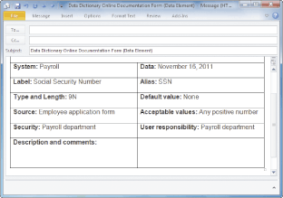
Data Dictionary
Documenting the Data Elements
You must document every data element in the data dictionary
The objective is the same: to provide clear, comprehensive information about the data and processes that make up the system

Slide 24
Data Dictionary
Documenting the Data Elements
The following attributes usually are recorded and described
Data element name and label
Alias
Type and length
Default value
Acceptable values - Domain and validity rules

Slide 25
Data Dictionary
Documenting the Data Elements
The following attributes usually are recorded and described
Source
Security
Responsible user(s)
Description and comments

Slide 26
Data Dictionary
Documenting the Data Flows
The typical attributes are as follows
Data flow name or label
Description
Alternate name(s)
Origin
Destination
Record
Volume and frequency

Slide 27
Data Dictionary
Documenting the Data Stores
Typical characteristics of a data store are
Data store name or label
Description
Alternate name(s)
Attributes
Volume and frequency

Slide 28
Data Dictionary
Documenting the Processes
Typical characteristics of a process
Process name or label
Description
Process number
Process description

Slide 29
Data Dictionary
Documenting the Entities
Typical characteristics of an entity include
Entity name
Description
Alternate name(s)
Input data flows
Output data flows

Slide 30
Data Dictionary
Documenting the Records
Typical characteristics of a record include
Record or data structure name
Definition or description
Alternate name(s)
Attributes

Slide 31
Data Dictionary
Data Dictionary Reports
Many valuable reports
An alphabetized list of all data elements by name
A report describing each data element and indicating the user or department that is responsible for data entry, updating, or deletion
A report of all data flows and data stores that use a particular data element
Detailed reports showing all characteristics of data elements, records, data flows, processes, or any other selected item stored in the data dictionary

Slide 32
Process Description Tools
A process description documents the details of a functional primitive, which represents a specific set of processing steps and business logic
It should be noted that this chapter deals with structured analysis, but the process description tools also can be used in object-oriented development, which is described in Chapter 6

Slide 33
Process Description Tools
Modular Design
Based on combinations of three logical structures, sometimes called control structures, which serve as building blocks for the process
Sequence
Selection
Iteration - looping

Slide 34
Process Description Tools
Structured English
Must conform to the following rules
Use only the three building blocks of sequence, selection, and iteration
Use indentation for readability
Use a limited vocabulary, including standard terms used in the data dictionary and specific words that describe the processing rules

Slide 35
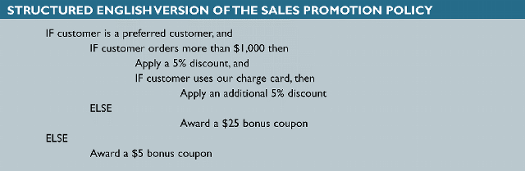
Process Description Tools
Structured English
Might look familiar to programming students because it resembles pseudocode
The primary purpose of structured English is to describe the underlying business logic

Slide 36
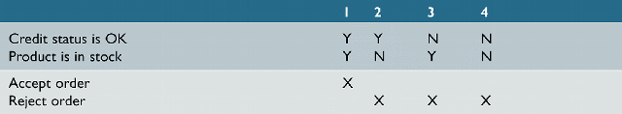
Process Description Tools
Decision Tables
Shows a logical structure, with all possible combinations of conditions and resulting actions
It is important to consider every possible outcome to ensure that you have overlooked nothing

Slide 37
Process Description Tools
Decision Tables
The number of rules doubles each time you add a condition
Can have more than two possible outcomes
Often are the best way to describe a complex set of conditions

Slide 38
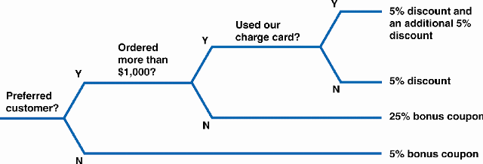
Process Description Tools
Decision Trees

Slide 39
Logical Versus Physical Models
While structured analysis tools are used to develop a logical model for a new information system, such tools also can be used to develop physical models of an information system
A physical model shows how the system’s requirements are implemented

Slide 40
Logical Versus Physical Models
Sequence of Models
Many systems analysts create a physical model of the current system and then develop a logical model of the current system before tackling a logical model of the new system
Performing that extra step allows them to understand the current system better

Slide 41
Logical Versus Physical Models
Four-Model Approach
Develop a physical model of the current system, a logical model of the current system, a logical model of the new system, and a physical model of the new system
The only disadvantage of the four-model approach is the added time and cost

Slide 42
Chapter Summary
During data and process modeling, a systems analyst develops graphical models to show how the system transforms data into useful information
The end product of data and process modeling is a logical model that will support business operations and meet user needs
Data and process modeling involves three main tools: data flow diagrams, a data dictionary, and process descriptions

Slide 43
Chapter Summary
Data flow diagrams (DFDs) graphically show the movement and transformation of data in the information system
DFDs use four symbols
A set of DFDs is like a pyramid with the context diagram at the top

Slide 44
Chapter Summary
The data dictionary is the central documentation tool for structured analysis
Each functional primitive process is documented using structured English, decision tables, and decision trees
Structured analysis tools can be used to develop a logical model during one systems analysis phase, and a physical model during the systems design phase

Slide 45
Chapter Summary
Chapter 5 complete

